Slide 1
4.1 OAIS, Repositories and Workflows
Christopher (Cal) Lee
callee@ils.unc.edu
September 12, 2016
Open Source Enterprise
Reston, VA, USA
September 7-20, 2016

Slide 2
Outline
OAIS – Background, development, implications
From OAIS Model to working archives – emergence of “micro-services” concept
Strategies for modeling workflows
Workflow Exercise

Slide 3
Problem in the World: Digital Preservation
Dramatic increase in creation and use of digital objects
Technological dependency, obsolescence and mismanagement threaten long-term use

Slide 4
Digital Preservation Up to Mid-1990s
Dramatic increase in creation and use of digital objects
Technological dependency, obsolescence and mismanagement threaten long-term use
Several separate streams of activity
General lack of consensus on approaches, terminology and standards
Notes:
Streams of activity:
Care for physical media
Hardware & software interoperability
Management of institutional archives & personal papers
Social science data archives
Earth and space science data archives
Management & provision of access to digital library collections

Slide 5
Crossing the Streams
Increasing recognition of common concerns
Increasing prominence of ICT infrastructure and associated standards development
Broadening societal awareness of digital preservation problems

Slide 6
Reference Model for an Open Archival Information System (OAIS)
ISO Standard – Developed 1995-2002 within the Consultative Committee for Space Data Systems (CCSDS)
Defines archival information systems at high level of abstraction
OAIS = “An Archive, consisting of an organization, which may be part of a larger organization, of people and systems that has accepted the responsibility to preserve information and make it available for a Designated Community”
Concern with the “long term”
Notes:
The OAIS falls under Technical Committee 20 (Aircraft and Space Vehicles), Subcommittee 13 (Space Data and Information Transfer Systems). The formal Secretariat for TC 20/SC 13 is the American National Standards Institute (ANSI), and it is administered by the U.S. National Aeronautic and Space Administration (NASA). The Consultative Committee for Space Data Systems (CCSDS), the body responsible for development of the OAIS, is a liaison organization to TC 20/SC 13.
ISO 14721

Slide 7
Part 1: Fundamental OAIS Terms and Concepts

Slide 8
Duties to the Designated Community (DC)
DC is set of one or more “user communities” that the OAIS is serving
OAIS is responsible for digital information over the “long term,” which is “long enough to be concerned with the impacts of changing technologies, including support for new media and data formats, or with a changing user community”
A fundamental challenge is to ensure that digital information is “independently understandable” to the DC, i.e. understood “without having to resort to special resources not widely available, including named individuals”
DC has a “knowledge base,” which can change over time.
OAIS must also “ensure that the information is preserved against all reasonable contingencies, including the demise of the Archive, ensuring that it is never deleted unless allowed as part of an approved strategy” and “enable the information to be disseminated as copies of, or as traceable to, the original submitted Data Objects with evidence ensuring its Authenticity”

Slide 9
Not Just Bits
“Content Information” to be preserved by an archive is composed not only of a “set of bit sequences” (the “data object”) but also associated sufficient “Representation Information” to allow bits to be rendered, used and understood.
OAIS should “understand the Knowledge Base of its DC to understand minimum Representation Information that must be maintained”
OAIS can maintain minimum Representation Information needed for its DC, or “a larger amount of Representation Information that may allow understanding by a larger Consumer community with a less specialized Knowledge Base.”

Slide 10
Roles Played by Entities Interacting with an OAIS
Producers - “persons, or client systems, who provide the information to be preserved”
Consumers - “persons, or client systems, who interact with OAIS services to find preserved information of interest and to access that information in detail”
Management - “the role played by those who set overall OAIS policy as one component in a broader policy domain”

Slide 11
Categories of Association between Archives
Independent - “no management or technical interaction”
Cooperating - “potential common producers, common submission standards, and common dissemination standards, but no common finding aids”
Federated - serve “both a Local Community (i.e., the original Designated Community served by the archive) and a Global community (i.e., an extended Designated Community) which has interests in the holdings of several OAIS archives and has influenced those archives to provide access to their holdings via one or more common finding aids”
Shared resources - agree to share resources between archives, which “requires various standards internal to the archive (such as ingest-storage and access-storage interface standards), but does not alter the user community’s view of the archive”

Slide 12
Part 2: OAIS Functional Model

Slide 13
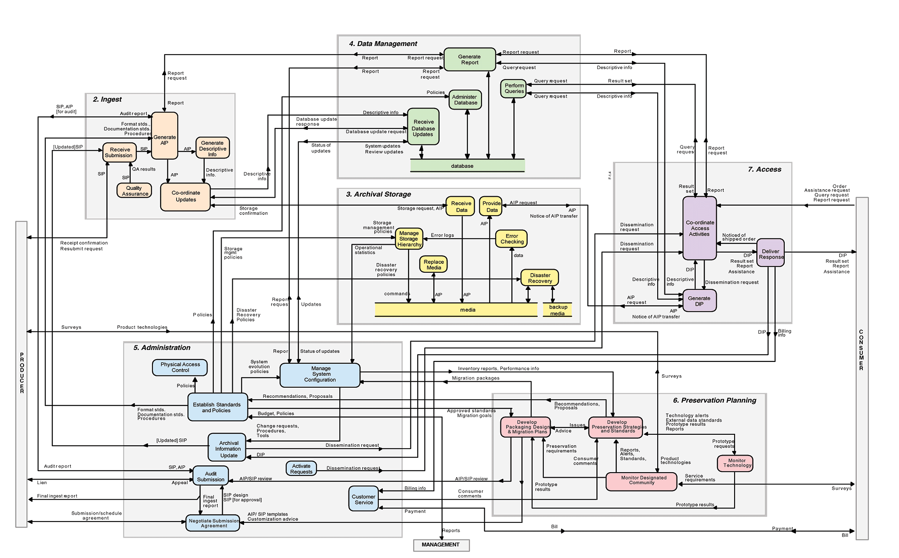
All the Grubby Details…

Slide 14
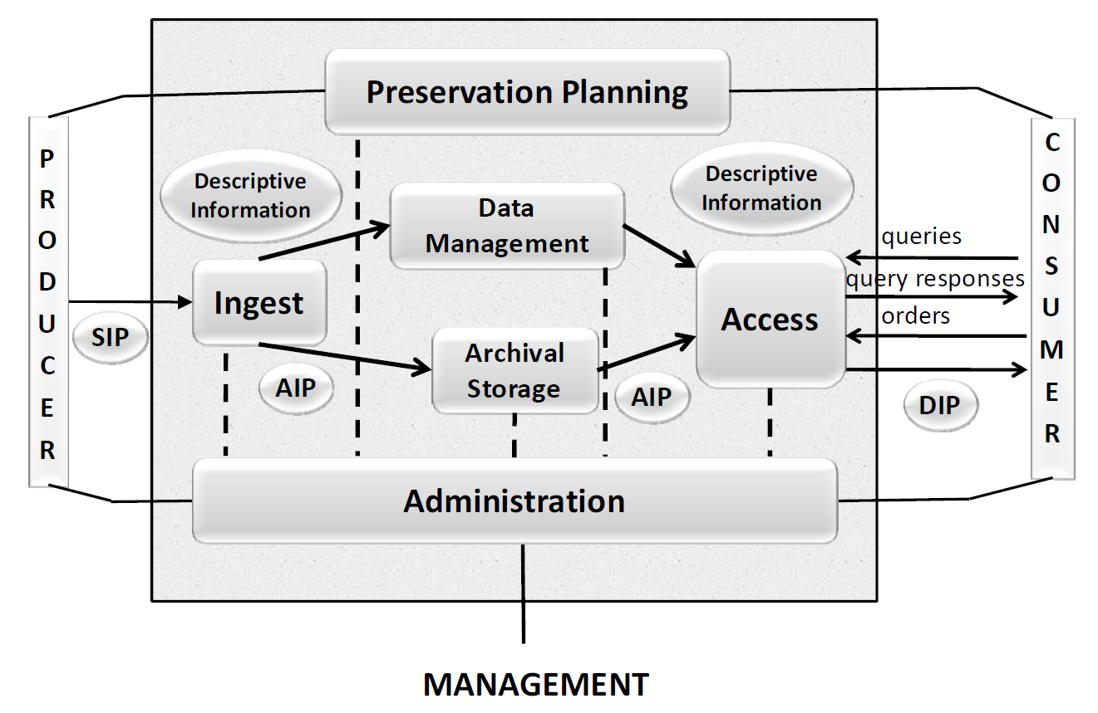
Reference Model for an Open Archival Information System, Figure 4-1: OAIS Functional Entities

Slide 15
Part 3: OAIS Information Model

Slide 16
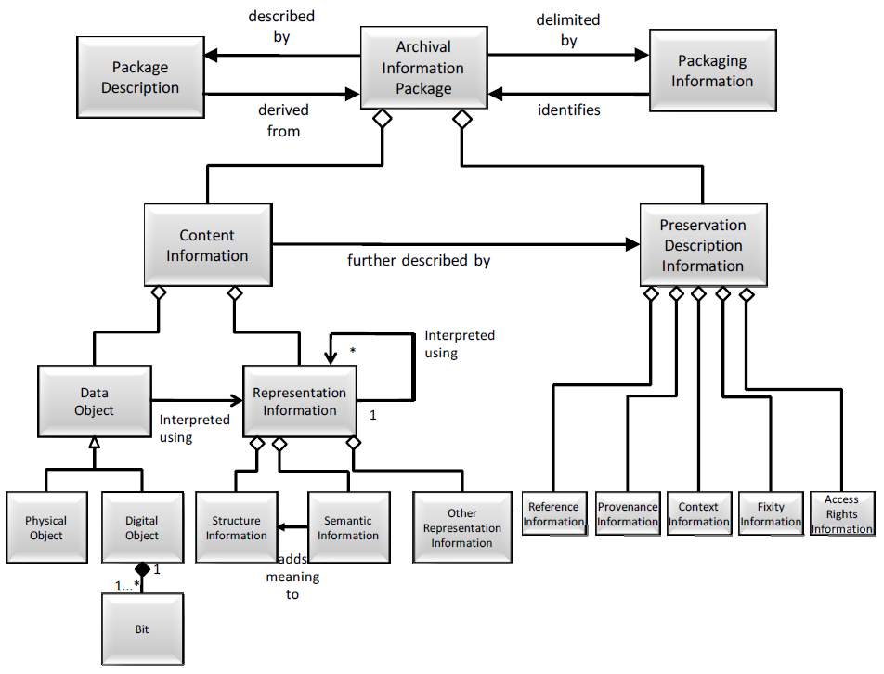
Archival Information Package (Detailed View) – Source: Reference Model for an Open Archival Information System (OAIS); Consultative Committee for Space Data Systems: Washington, DC, 2012; 4-40.

Slide 17
Part 4: Where’s the metadata?

Slide 18
Archival Information Package (Detailed View) – Source: Reference Model for an Open Archival Information System (OAIS); Consultative Committee for Space Data Systems: Washington, DC, 2012; 4-40.

Slide 19
Archival Information Package (Detailed View) – Source: Reference Model for an Open Archival Information System (OAIS); Consultative Committee for Space Data Systems: Washington, DC, 2012; 4-40.

Slide 20
Archival Information Package (Detailed View) – Source: Reference Model for an Open Archival Information System (OAIS); Consultative Committee for Space Data Systems: Washington, DC, 2012; 4-40.

Slide 21
Archival Information Package (Detailed View) – Source: Reference Model for an Open Archival Information System (OAIS); Consultative Committee for Space Data Systems: Washington, DC, 2012; 4-40.

Slide 22
Archival Information Package (Detailed View) – Source: Reference Model for an Open Archival Information System (OAIS); Consultative Committee for Space Data Systems: Washington, DC, 2012; 4-40.

Slide 23
Archival Information Package (Detailed View) – Source: Reference Model for an Open Archival Information System (OAIS); Consultative Committee for Space Data Systems: Washington, DC, 2012; 4-40.

Slide 24
Archival Information Package (Detailed View) – Source: Reference Model for an Open Archival Information System (OAIS); Consultative Committee for Space Data Systems: Washington, DC, 2012; 4-40.

Slide 25
Organizational Context of OAIS Development – Adapted from: Lee, C. Defining Digital Preservation Work: A Case Study of the Development of the Reference model for an Open Archival Information System. Doctoral Dissertation, University of Michigan, 2005.
Notes:
Quick summary of this picture, showing how the OAIS (yellow box) fits into the larger structure of standardization within ISO, CCSDS and NASA. Point out how space-data and NASA-centric this context is.

Slide 26
The “Open” in OAIS
Open = “developed in open forums”
Began as standard for “digital information obtained from observations of the terrestrial and space environments”
Development soon involved participants from diverse set of institutions and professions
Basis for research, development and discussion for a broad and diverse set of actors
Notes:
Even before it had reached any formally approved status within the CCSDS or International Organization for Standardization (ISO), the OAIS received considerable attention from those engaged in digital preservation research and development. Over the past several years, the OAIS has come to be a widely assumed basis for research and development on digital archiving. Conference papers, articles and reports that present findings on digital archives are generally expected to base their work on the OAIS, indicate how their contributions can be mapped to it or explain why they have not done so.
The OAIS has become “the reference model of choice of those involved in digital preservation worldwide” (Greenstein and Smith, 2003). OAIS-compliance has been a stated fundamental design requirement for major digital preservation and repository development efforts at the U.S. National Archives (NARA), U.S. Library of Congress (LC), British Library, National Library of France (BnF), National Library of the Netherlands (KB), the Digital Curation Centre (DCC) in the UK, as well as several space agencies. The OAIS is playing prominently in discussions of future funding efforts by both NSF and JISC in the UK. The OAIS has also served as the basis for several very prominent digital preservation metadata initiatives, including CEDARS (CURL Exemplars in Digital Archives), NEDLIB (Networked European Deposit Library), and two joint Research Libraries Group (RLG) / Online Computer Library Center (OCLC) efforts – the Working Group on Preservation Metadata and then the Preservation Metadata Implementation Strategies (PREMIS) Working Group. RLG and OCLC have also jointly developed guidance on attributes of trusted digital repositories, which builds off of the OAIS. One of the earliest activities of the Digital Preservation Coalition (DPC) in the UK after its formation in 2001 was to develop, along with the British National Space Centre (BNSC), a seminar to discuss and “raise the profile of” the OAIS. The CCSDS is undertaking efforts to developed follow-on standards based on the OAIS, starting with the Producer-Archive Interface Methodology Abstract Standard (PAIMAS), which reached Blue Book status in December 2003. RLG and NARA have formed the Digital Repository Certification Task Force, whose efforts are explicitly tied to the OAIS and intended to contribute to the ISO Archiving standardization efforts. A large number of other research and development projects are either based on or claim conformance to the OAIS.

Slide 27
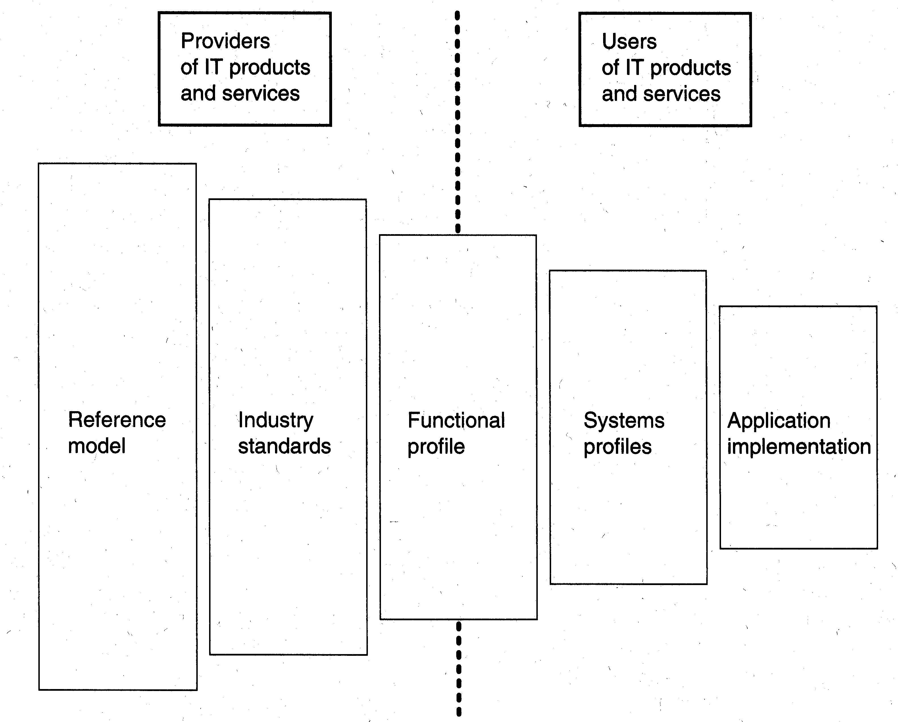
The User-Provider Standardization Planning Model [Source: Cargill, 1997, p. 92]
Notes:
This is a fairly linear view of standards. It doesn’t directly address factors such as feedback or the interactions between those who make use of standards.

Slide 28
Part 5: The OAIS Development Process*
*See Christopher A. Lee, Defining Digital Preservation Work: A Case Study of the Development of the Reference Model for an Open Archival Information System, Doctoral Dissertation (Ann Arbor, MI, 2005), http://www.ils.unc.edu/callee/dissertation_callee.pdf
Notes:
Transition to next slide: Let’s look first at what makes this a particularly compelling case to investigate…

Slide 29
Participation Patterns
36 Workshops
18 US Workshops (working meetings)
13 International Workshops (formal review)
5 Open Workshops (wider review & input)
Large number of total participants (306) with about 20% of them attending more than one meeting

Slide 30
Consistent and Transient Participants
Consistently Active Participants
Largely affiliated with space agencies, especially NASA
Provided ongoing contributions to writing, editing or review
Legitimate Peripheral Participants (Lave & Wenger, 1991)
From more diverse set of institutional contexts
Provided reality check on applicability of standard beyond space data centers
Some fundamental contributions to the document

Slide 31
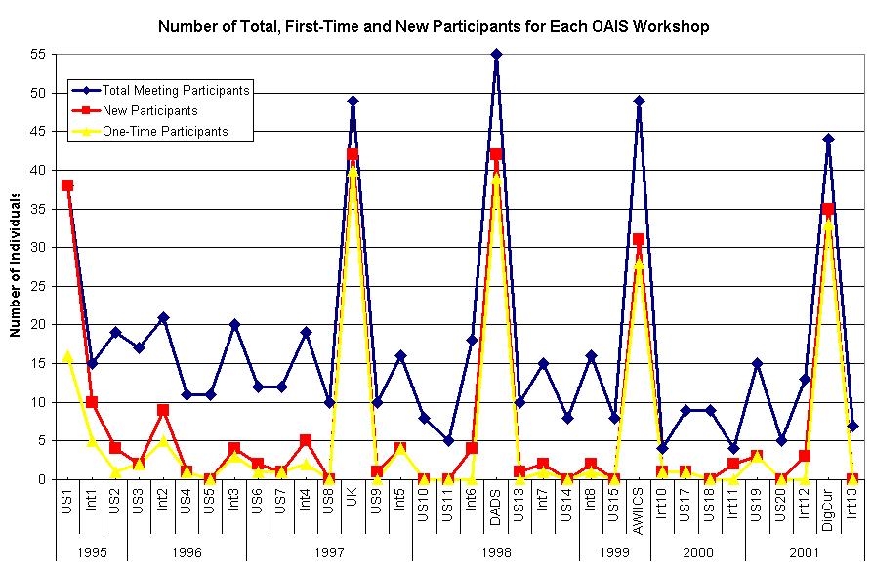
Open Workshops
Notes:
This picture illustrates participation patterns within my classification of 3 types of workshops: green are US, purple are International, and orange are Open. Open Workshops had large proportion of new and one-time participants. The same can be said of organizational actors at the three types of workshops.

Slide 32
Document Revisions
20 total versions
CCSDS path:
Draft
[8]
White Book
(ISO Working Draft)
[7]
Red Book
(ISO Committee Draft)
[4]
Blue Book
(ISO Draft
Intl Stand)
[1]
Significant early negotiation & revisions
Later changes were less frequent & more limited in scope

Slide 33
Examples of Major Issues Discussed at OAIS Workshops

Slide 34
What is the scope of the document?
Just digital data or also include physical?
If a reference model is to be “implementation-independent,” what does this exclude (e.g. migration approaches)?
Contents and scope of “common services”?
Notes:
The idea of modeling has a long tradition in such diverse fields as art, architecture, mathematics, economics, engineering and numerous sciences. It generally involves the construction of a simplified but representative version of something else.
Those working with a model tend to be aware that it is not an exact copy of the thing that it is modeling, but it is hoped to reflect enough of the relevant attributes to serve some specific purpose (e.g. storage in human memory or scientific analysis of a complex problem space). One can model a thing or state that already exists in the world or something that does not actually exist, but could hypothetically. For purposes of design, a model can serve as a proxy for some potential location in design space. If the model seems to hold up under scrutiny, then one can decide to commit the resources to moving in that direction.
The question of which attributes are relevant enough to include in the model cannot be answered through analysis alone, because it must account for the purpose and context of the model's use.
According to the Blue Book, Common Services: The supporting services such as inter-process communication, name services, temporary storage allocation, exception handling, security, and directory services necessary to support the OAIS.
To reiterate, an important aspect of any model is what details it abstracts away. And also what terms it defines, which it takes for granted as understood and which it leaves out entirely…

Slide 35
What needs to be defined?
Science data domain (e.g. ingest)
“Traditional archives” domain (e.g. provenance)
Common across domains (e.g. collection)
Terms to distinguish domains (e.g. document vs. observational data

Slide 36
Notes:
Version 6 was almost twice as along as Version 5, and it included 33 new terms in the definitions section (the most for any version of the reference model). Seven of these were terms that appeared in the section as placeholders but did not yet include a definition, meaning there were actually 26 new definitions. Twenty seven (82%) of the new terms had been used in the body of the previous version, indicating that much of the change to the definitions section reflected an effort to bring it up-to-date with the contents of the body of the document, rather than the introduction of a large number of new ideas or concepts.
Version 7 listed 26 new terms in the definitions section, second only to Version 6. As with Version 6, several (7) of these terms were listed in the section as placeholders and did not actually provide definitions, meaning there were actually nineteen new definitions. As with Version 6, a large proportion (23 or 88%) of the new terms had also been used in the body of the previous version.

Slide 37
A major factor in success of OAIS was the timing of the development effort.
Actors within several streams of activity related to digital preservation perceived the need for a high-level model but had not themselves developed one.
Several actors responsible for digital data now felt they had valuable knowledge related to their recent digital archiving efforts within their own local contexts, which they could use to inform the development of the more general Reference Model.

Slide 38
Contributions to the development of the OAIS took various forms.
Writing and editing
Administration of the process
Development of external documentary artifacts
Identifying and locating relevant artifacts in the environment
Mapping the Reference Model to local contexts
Informal verbal commentary
Enrollment of other actors
Serving as conduit for comments of others
Representing interests of those not present at Workshops
Testing of the Reference Model
Acts of signification & legitimation through all of the above
Notes:
After this slide.
It’s now time for me to tell you one of my dad’s favorite jokes. You’ll have to help me with this. Are you ready?
Many have asked what the most important ingredient of comedy is. I can tell you that the answer is. So, just go ahead and ask me. “ What’s the most important ingredient in comedy?”
Timing

Slide 39
Lessons for Standards Development
Timing is an essential factor
Value of multiple discussion and decision-making forums (three types of ISO Archiving Workshops)
Importance of cultivating many types of contribution – not just writing, editing and voting
Much important activity takes place outside formal SDO process
All of the above are factors that existing literature has generally failed to address
Notes:
One of my dad’s favorite jokes:
What’s the most important ingredient in comedy? Go ahead. Ask me, “What’s the most important ingredient in comedy?” - Timing

Slide 40
OAIS-Based Activities
Lots of research & development
Development/evaluation of systems with conformance to OAIS as a primary goal – some federal government examples:
Government Printing Office (FDsys)
National Library of Medicine
Research agendas
Professional development
Audit & certification
Producer-Archive Interface Methodology Abstract Standard (PAIMAS)

Slide 41
CCSDS Reorganization - 2003
OAIS and associated standards are now within purview of Mission Operations and Information Management Services (MOIMS) Area, part of the Space Informatics Domain
New MOIMS Working Group, known as Archive Ingest (MOIMS-DAI) took over work on archival standards that previously took place within Panel 2 of the CCSDS
Most of the focus of MOIMS-DAI has been on standards related to Ingest, but it’s also overseen review and revision of the OAIS Reference Model
Identification of several new types of publications, including: Magenta Book category (Recommended Practices) to be distinguished from the existing Blue Book category (Recommended Standards) - when OAIS was up for renewal, it was reviewed and reissued as a Magenta Book

Slide 42
Five-Year Review of OAIS - 2012
Call for comments in 2006 - received eleven separate documents containing comments
Revised edition approved through the CCSDS as a Magenta Book (CCSDS 650.0-M-2) and through the ISO as a new version of the International Standard (ISO 14721:2012).

Slide 43
Changes in 2012 Edition
Ranged from cosmetic to substantive
Particularly notable: added concepts of Authenticity, Information Property and Transformational Information Property; added Access Rights information to information model
New text about rationale for the reference model, to further explain the process of negotiating for submissions and relationships between those submissions and packages that are preserving within the archive
All figures (except for Figure C-1) changed to reflect different visual conventions - some figures also reflect changes in wording or relationships represented between entities
Several passages and figures edited to reflect risk management considerations
Several illustrative examples added or expanded
Citations added to reflect recent standards activities
Annexes: several revised, one removed, and one added
Specific phrases globally replaced, e.g. “result set” → “query response”; “staging area” or “staging storage” → “temporary storage area”
Definitions: 13 added, 23 revised, and 3 removed
Passages revised to further address payment for access and access restrictions, further clarifying that “open” in OAIS does not mean all information is necessarily publicly available.
Further discussion of emulation as a viable preservation strategy – changed from “has not yet been shown to be cost-effective” to “is an area of active research”

Slide 44
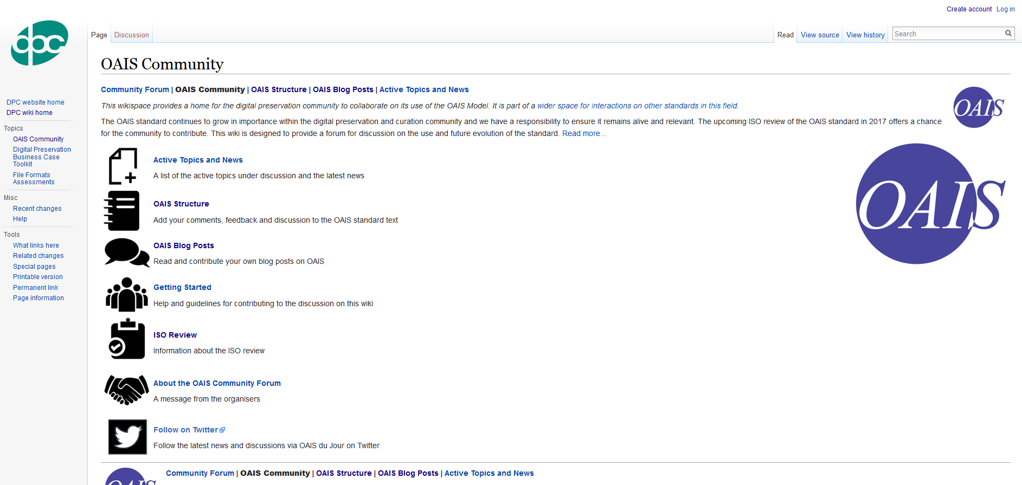
Another Five-Year Review - 2017
http://wiki.dpconline.org/index.php?title=OAIS_Community

Slide 45
Question to Consider: How much time and attention should be devoted to getting ingest right, in light of all the other tasks and responsibilities of records professionals?

Slide 46
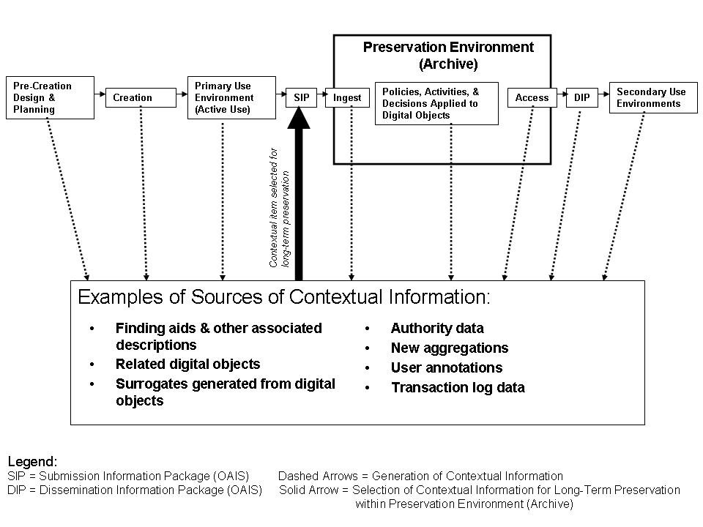

Slide 47
Primary Focus of Traditional Archival Description

Slide 48
Primary Focus of Traditional Archival Arrangement

Slide 49
For a repository to ensure long-term availability of contextual information, it must ingest it or take other measures to ensure it’s preserved

Slide 50
Digital Curation Includes many Activities Outside the Scope of the OAIS Reference Model
“Electronic Data Management (EDM) is necessary to manage information from initial ingest into the Intelligence Community Information Technology Enterprise (IC ITE) through final data disposition, in accordance with legislation such as the Federal Records Act, Freedom of Information Act (FOIA), Privacy Act, and direction from the Executive Branch.”
“Abstract Data Definition for Electronic Records Management,” Version 2014-DEC, Intelligence Community Technical Specification, Office of the Director of National Intelligence, December 22, 2014.

Slide 51
But the OAIS can also be a useful resource to plan for curation of even short-term data
In a previous class here, one of your colleagues suggested that the OAIS would be very useful for design and management of information systems outside of repositories, e.g. IC ITE
It can also be used in risk management (to be discussed in the next module)

Slide 52
Part 6: A Big (Common) Idea:
Micro-services

Slide 53
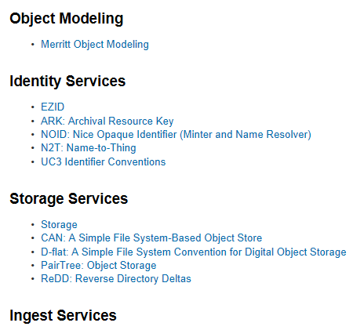
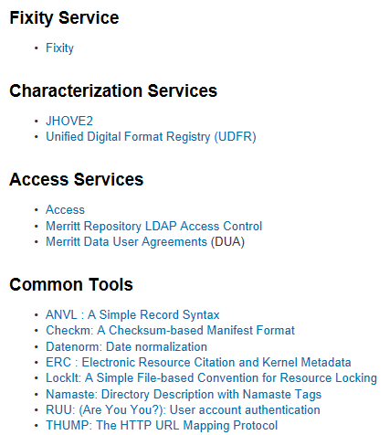

California Digital Library - Microservices
https://wiki.ucop.edu/display/Curation/Microservices

Slide 54
Archivematica - Artefactual Systems

Slide 55
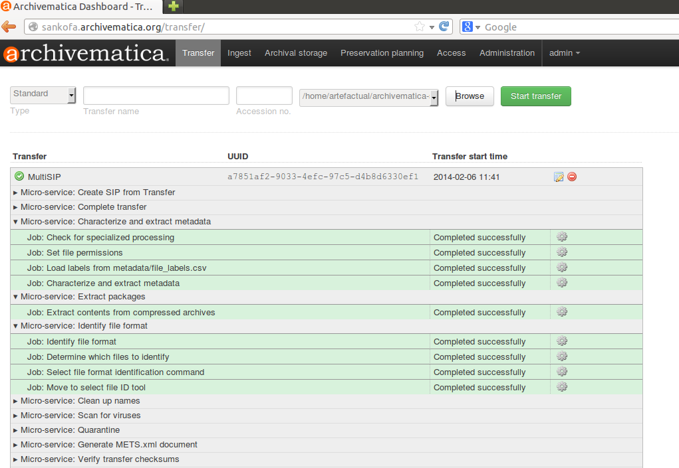
https://wiki.archivematica.org/images/4/45/Micro-services1.png

Slide 56
Integrated Rule-Oriented Data System (iRODS)

Slide 57
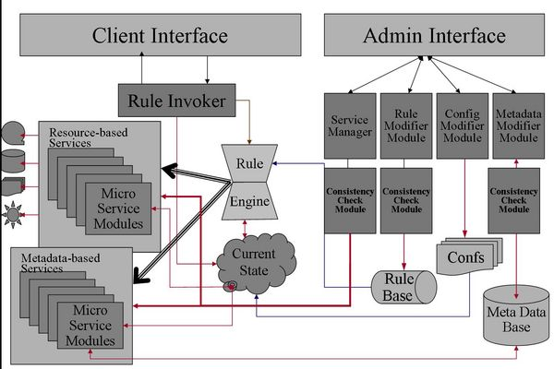
https://www.irods.org/images/thumb/5/5c/irodsArch.jpg/600px-irodsArch.jpg

Slide 58
Safety Deposit Box (SDB) – Tessella*
*See also Preservica

Slide 59
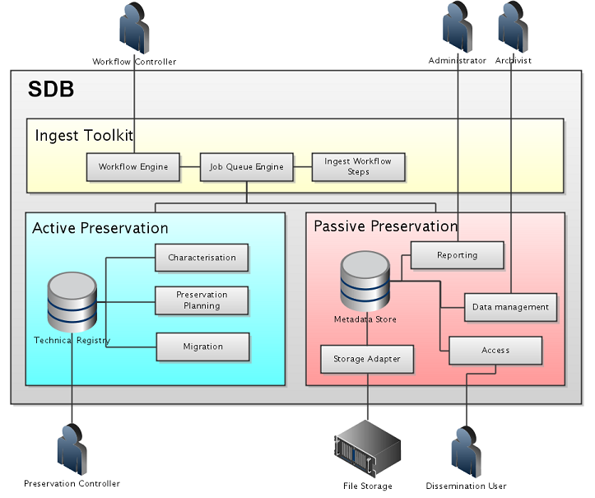
http://lib.stanford.edu/files/PASIG-DC.ppt

Slide 60
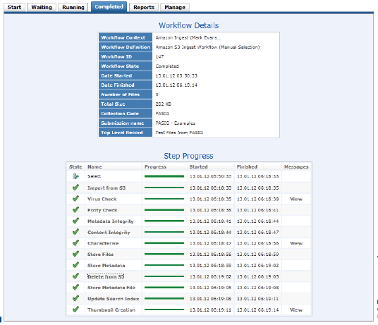
http://lib.stanford.edu/files/pasig-jan2012/13J4%20Evans%20PASIG%20CloudSolution-Mark%20Evans.pdf

Slide 61
Part 7: Example of System for Data Sets – DataVerse Network (DVN)

Slide 62
Dataverse Network (DVN)
Open source web application developed by the Institute for Quantitative Social Science (IQSS) at Harvard University “to share, preserve, cite, explore and analyze research data.”
A Dataverse repository can host multiple “dataverses.”
Datasets include both data files and descriptive metadata (documentation and possibly code).

Slide 63
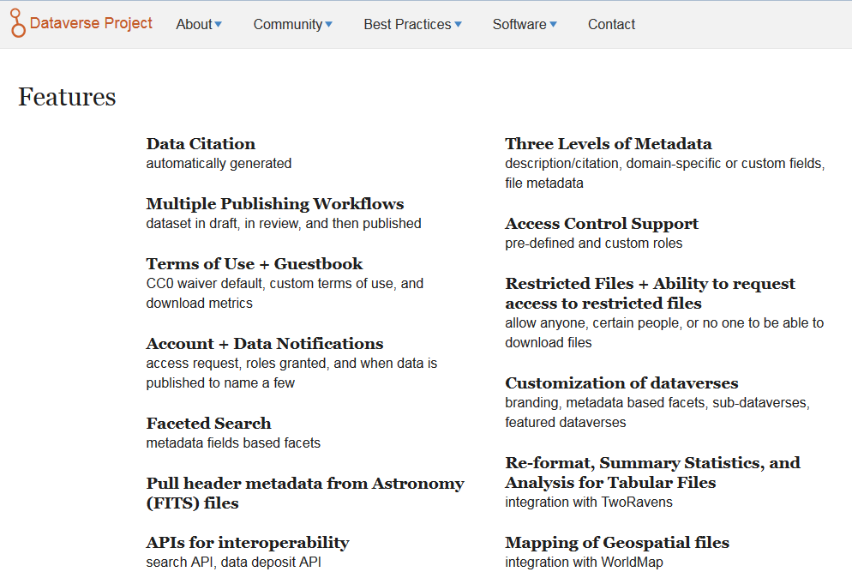
http://dataverse.org/software-features

Slide 64
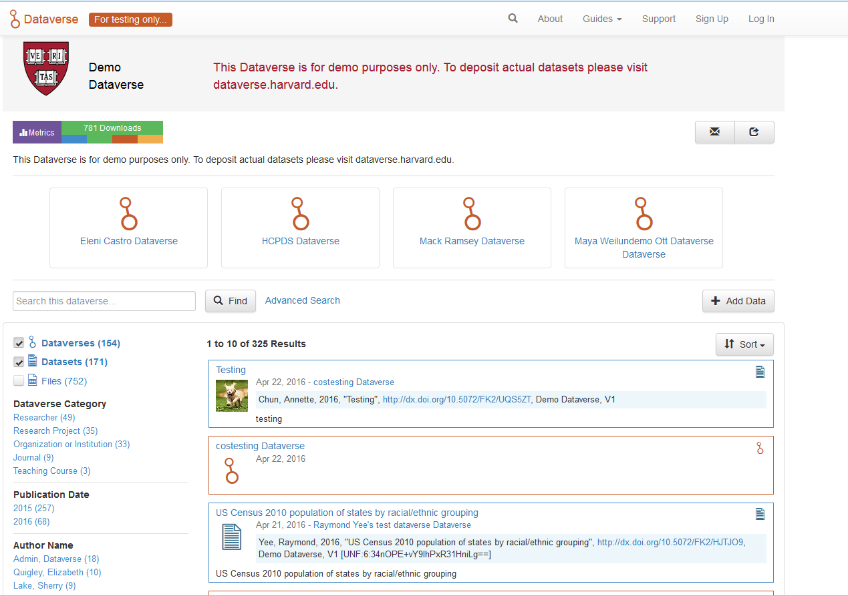
https://demo.dataverse.org/

Slide 65
Part 8: Representing Workflows

Slide 66
Work Flow – The Thing to be Represented
“the sequence of processes through which a piece of work passes from initiation to completion”
(Oxford English Dictionary, Second Edition, 1989)

Slide 67
Workflows vs. Functions
Functions are generally expressed to be “workflow agnostic”
In practice, the functions have to be pieced together in specific ways that are appropriate to the particular context
If the functions are the verbs, then the workflows are the sentences (or paragraphs...)

Slide 68
Work Flows as Models – Representations of the Thing
Explicit, symbolic representation of the workflow
Usually inspired by new system design or attempts to reengineer a process
There are many different ways to model a workflow
But the basic components tend to be similar

Slide 69
Models and Abstractions are Essential for Work in a Complex World
Model – Simplified but representative version of something else
Abstraction - Hides complexity while still acknowledging that it exists
Two senses of abstraction* – Free of specific content (context independent) and formally specified
*Andrew Delano Abbott, The System of Professions: An Essay on the Division of Expert Labor (Chicago: University of Chicago Press, 1988).
Notes:
According to Brian Cantwell Smith (1996), a model necessarily does “a certain amount of violence to its subject matter.”
Model, important considerations relate to what attributes in the world to identify and which to leave either undefined or explicitly excluded as outside the scope of the model.
Determining which attributes are relevant can’t be answered through analysis alone; must account for purpose and context.

Slide 70
Models
Purposely simplified view of reality
Valuable for planning & making inferences
No single model will be appropriate for all purposes
Varing levels of detail & granularity
Often serve as boundary objects

Slide 71
“To build a model is to conceive of the world in a certain delimited way.” (p.815) “...every act of conceptualization, analysis, categorization, does a certain amount of violence to its subject matter, in order to get at the underlying regularities that group things together. If you don't commit that act of violence -- don't ignore some of what's going on -- you would become so hypersensitive and so overcome with complexity that you would be unable to act.” (p.816)
Smith, Brian Cantwell. "Limits of Correctness in Computers." In Computerization and Controversy: Value Conflicts and Social Choices, edited by Rob Kling, 810-25. San Diego, CA: Academic Press, 1996.

Slide 72
Important Modeling Considerations
What attributes in the world to identify and which to leave either undefined or explicitly excluded as outside the scope of the model
Determining which attributes are relevant can’t be answered through analysis alone; must account for purpose and context

Slide 73
Parts of a Workflow
Entities/Stages – where something happens (e.g. data are transformed, someone makes a decision, data are captured)
Input(s) – control and/or information that flows into an entity/stage
Output(s) – control and/or information that flow out of an entity/stage

Slide 74
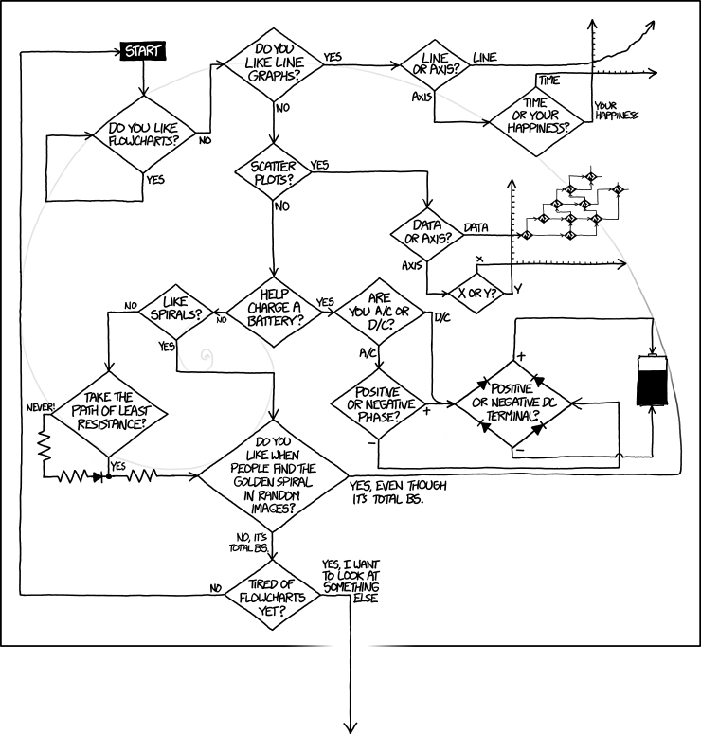
http://xkcd.com/1488/

Slide 75
Vital Factor that Sets Workflows and Systems Apart from Individual Tasks: Interoperability

Slide 76
Two Different Representation Goals
Describe what is being done now
To understand, analyze, audit current state of things
Should be explicitly tied to how things are currently done & who currently does them
Describe what you want to get done
To design new systems, reengineer processes
Should focus on the purposes & objectives of a process, rather than fixating on how things are currently done & who currently does them

Slide 77
Describing what you want to get done (process modeling)

Slide 78
Identifying a Process*
Name it
Verb-noun – e.g. generate AIP, harvest web site
Verb-qualifier-noun – e.g. generate descriptive information, develop preservation strategy
Verb-noun-noun – e.g. assign file permissions, verify object integrity
Ensure there is a clearly intended result
Test: noun-is-verbed form (e.g. AIP is generated, web site is harvested, object integrity is verified
*Sharp, Alec, and Patrick McDermott. Wokflow Modeling: Tools for Process Improvement and Applications Development. 2nd ed. Boston, MA: Artech House, 2009. p.40

Slide 79
Criteria for Identified Result*
Discrete and identifiable – “you can differentiate individual instances of the result, and it makes sense to talk about 'one of them‘”
Countable – “you can count how many of that result you've produced in an hour, a day, or a week”
Essential – “fundamentally necessary to the operation of the enterprise, not just a consequence of the current implementation,” i.e. “must focus on 'what, not who or how‘”
*Sharp, Alec, and Patrick McDermott. Wokflow Modeling: Tools for Process Improvement and Applications Development. 2nd ed. Boston, MA: Artech House, 2009. p.40-41

Slide 80
Part 9: Lab Exercise (See Document)

Slide 81
Post-Mortem Discussion

Slide 82
Characterizing Your Workflow
How did you decide what to label your sticky notes?
How did you decide how they should be arranged?
What was the hardest part of the process?
How did group products differ? Why?

Slide 83
Software to Support your Workflow
Can you identify specific tools to support parts of your workflow?
Did you identify any gaps (no tool support) or overlaps (multiple tools to support)?

Slide 84
Selection and Evaluation of Tools
How would you decide which tools to adopt?
What criteria would you use to evaluate the tools you’ve chosen?

